Slide 1
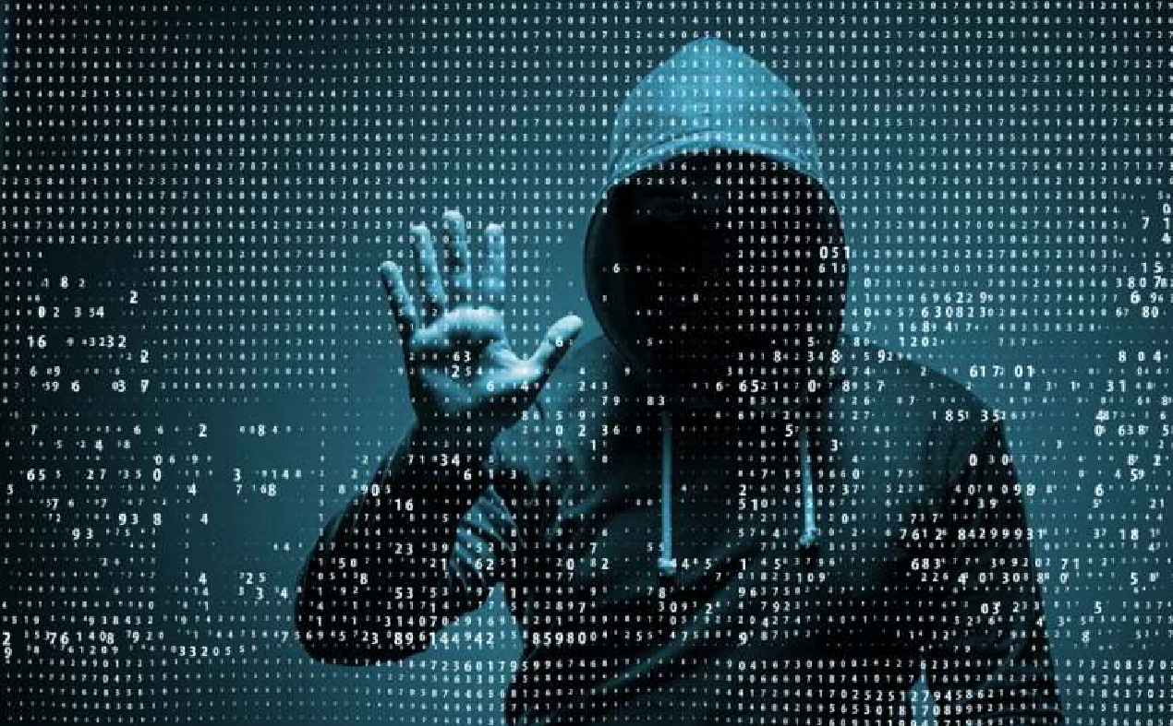
Cyber Security

Slide 2

CONTENT
Introduction
Understand :
What is the meaning of word “CYBER” ?.
What is the need of cyber security ?.
What are the security problems in cyber fields ?.
How to implement and maintain security of a cyber field around us?.

Slide 3
INTRODUCTION
The term Cyber Security is used to refer to the Security Offered through On-line services to protect your online information.
Information Technology or Cyber Security is the protection of computer systems from theft or damage to their Hardware ,Software or electronic data.

Slide 4

With an increasing amount of people getting connected to the internet , the security threats that cause massive harm are increasing also.

Slide 5
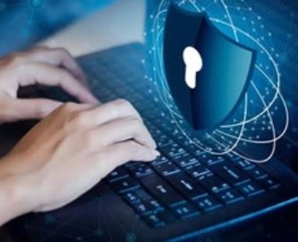
Meaning Cyber
CHARACTERISTIC OF THE CULTURE OF COMPUTERS, INFORMATION TECHNOLOGY, AND VIRTUAL REALITY

Slide 6
Need of Cyber Security
Cyber security is necessary since it helps in securing data from threats such as data theft or misuse, also safeguards your system from viruses.
Protect vital information while still allowing access to those who need it
Provide authentication and access control for resources
Guarantee availability of resources

Slide 7
WHY CYBER SECURITY?
The internet allows an attacker to attack from anywhere on the planet.
Risks caused by poor security knowledge and practice:
Identity Theft
Monetary Theft
Legal Ramifications (for yourself and companies)
Disciplinary Action if policies are not followed

Slide 8
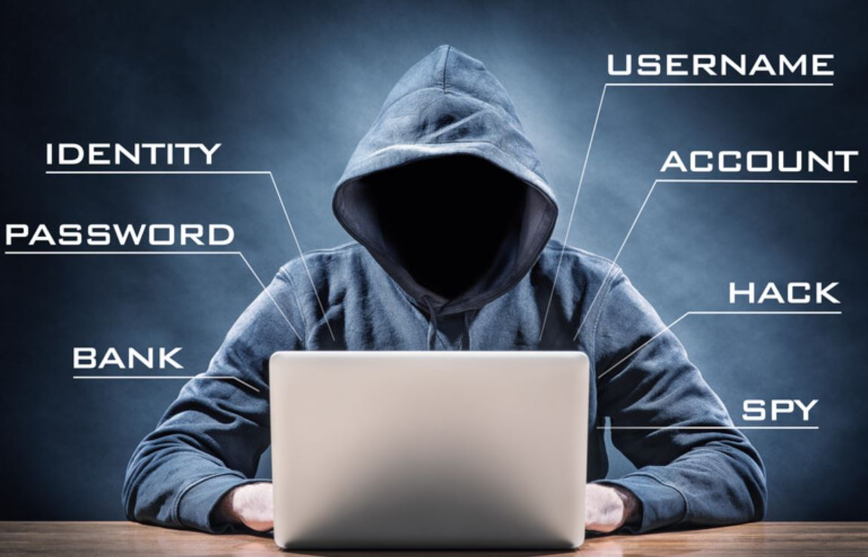
Hackers
In common a hacker is a person who breaks into computers, usually by gaining access to administrative controls.

Slide 9
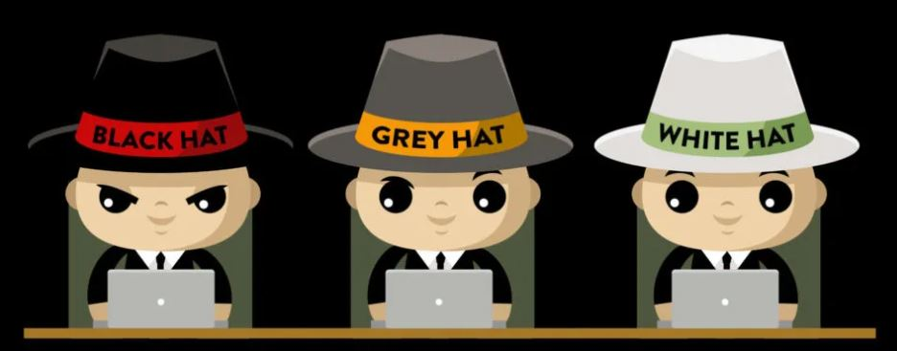
Types Of Hackers
White Hat Hacker
Grey Hat Hacker
Black Hat Hacker

Slide 10
White Hat Hacker
A white hat hacker is a computer security specialist who breaks into protected systems and networks to test and assess their security.
White hat hackers use their skills to improve security by exposing vulnerabilities(weaknesses) before malicious hackers (known as black hat hackers) can detect and exploit them.

Slide 11
Grey Hat Hacker
The term "grey hat", alternatively spelled as grey hat or "gray hat", refers to a computer hacker or computer security expert who may sometimes violate laws(illegal) or typical ethical standards, but does not have the malicious intent typical of a black hat hacker

Slide 12
Black Hat Hacker
Black hat refers to a hacker who breaks into a computer system or network with malicious intent. A black hat hacker may exploit security vulnerabilities for monetary gain; to steal or destroy private data , or to alter, disrupt or shut down websites and networks.

Slide 13
TYPES OF HACKERS
Professional hackers
Black Hats – the Bad Guys
White Hats – Professional Security Experts
Script kiddies
Mostly kids/students
User tools created by black hats
To get free stuff
Impress their peers
Not get caught
Underemployed Adult Hackers
Former Script Kiddies
Can’t get employment in the field
Want recognition in hacker community
Big in eastern European countries

Slide 14
TYPES OF HACKERS
Ideological Hackers
hack as a mechanism to promote some political or ideological purpose
Usually coincide with political events
Criminal Hackers
Real criminals, are in it for whatever they can get no matter who it hurts
Corporate Spies
Are relatively rare
Disgruntled Employees
Most dangerous to an enterprise as they are “insiders”
Since many companies subcontract their network services a disgruntled vendor could be very dangerous to the host enterprise

Slide 15

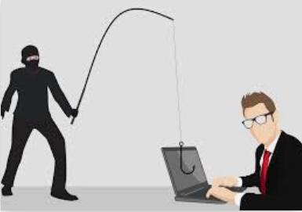
What is Identity Theft
when someone uses another person's personal identifying information, like their name, identifying number, or credit card number, without their permission, to commit fraud or other crimes.

Slide 16
What Thieves can do with your Identity
Open new credit cards using your identifying information.
Make unauthorized purchases using your existing credit and debit cards.
Use your health insurance to get medical care.
File a tax return using your Social Security number in order to claim your refund.
Take Mobile connection and will uses it for illegal activity.

Slide 17
Types Of Fraud
Credit Card
Phone and Utility
Government Doc
Bank Fraud
Loan Fraud
Others

Slide 18
How does identity theft happen?
Phishing
Skimming
Dumpster diving
Wi-Fi hacking
Phone scams
Malware
Shoulder Surfing
Impersonate

Slide 19
Phishing
Fruadsters send fraudulent emails or texts that may look legitimate. The links in these emails or texts may be used to download malicious software. The software may be able to mine your computer for personal information and send it to a remote computer.
Cybercriminals uses this information to commit identity theft. It’s a good idea to never open suspicious-looking mails, click on links or download material

Slide 20
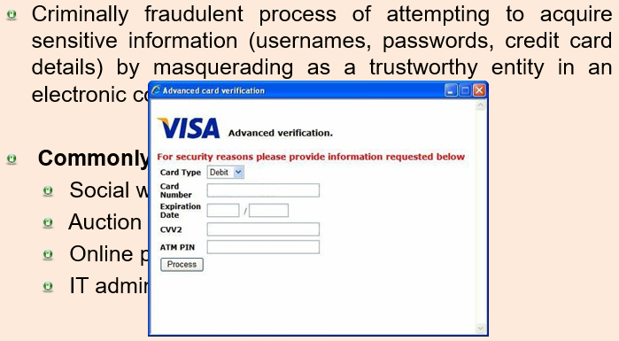
Phishing

Slide 21
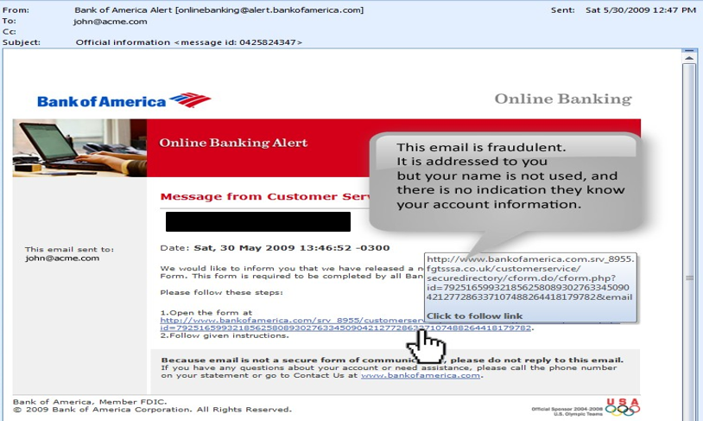
Phishing

Slide 22
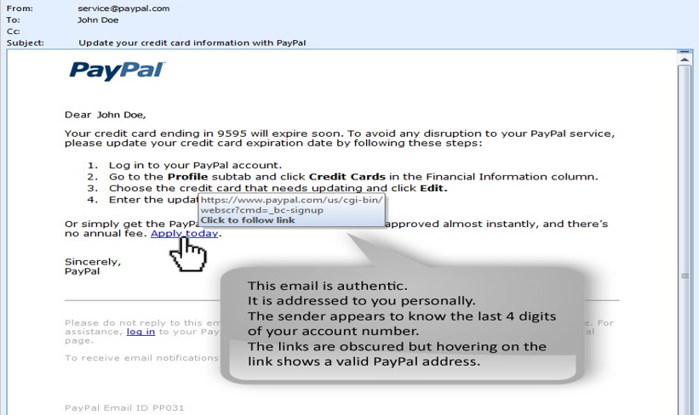
Phishing

Slide 23
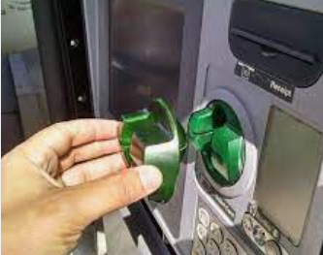
Skimming
Skimming occurs when devices illegally installed on ATMs, point-of-sale (POS) terminals, or fuel pumps capture data or record cardholders' PINs. Criminals use the data to create fake debit or credit cards and then steal from victims' accounts.

Slide 24
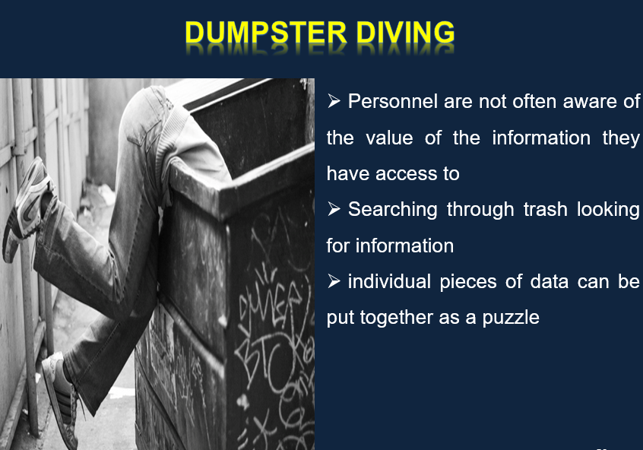
Dumpster Diving

Slide 25

Wi-Fi Hacking
Some public Wi-Fi connections are unencrypted. This could give criminals a chance to snoop on data traveling to and from your device. If your device has software vulnerabilities, cybercriminals may be able to inject malware to help them gain access to your data.

Slide 26
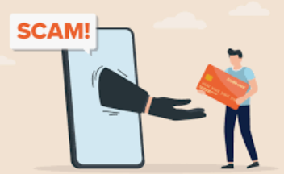
Phone Scams
Fraudsters may call you on the phone, claiming to be from a bank. If you receive this kind of call, don’t provide any information over the phone.

Slide 27
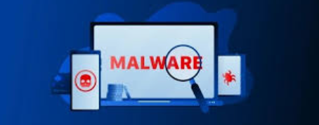
MalWare
Fraudsters use different techniques to install malware on another person's device. Malware could allow the criminal to access the device and information stored on it. Malware types include viruses, spyware, trojans, keyloggers.

Slide 28
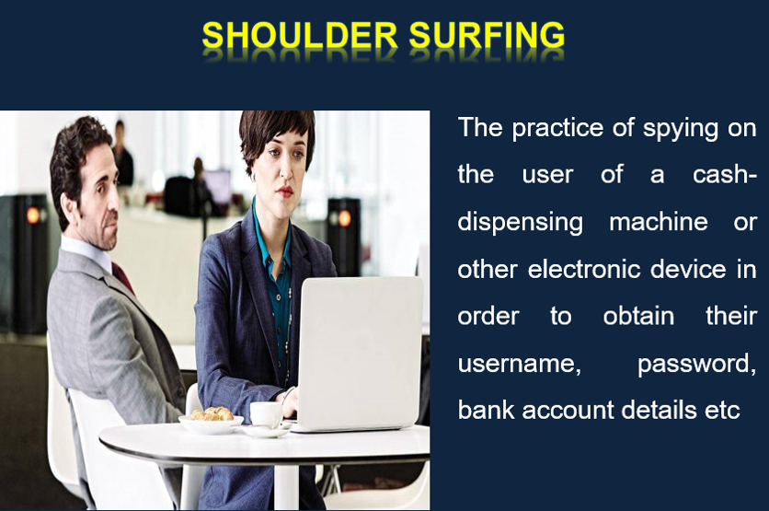
Shoulder Surfing

Slide 29

Impersonation
Creating a fake identity or using someone else’s name may be easier than ever before, thanks to the internet. Impersonation fraudsters take advantage of all the information available on the web to commit identity scams, for example by pretending to be someone else on social media.

